Slide 1

Loops, break and continue
19CSE102 Computer Programming
Lecture 3

Slide 2
C Iteration Statements (Loops)
A Loop executes the sequence of statements many times until the stated condition becomes false.
it repeats the set of statements until the condition for termination is met.
Iteration statements in C are
while
do-while
for
Notes:
Let us see the nested for loop in detail in Python Programming we can write for loop as a nested loop the general Syntax of a nested for loop is shown in the slide the outer Lo should be a follow along with an expression for a condition similarly the inner no should contain expression for a condition we can have statements written inside these loops

Slide 3
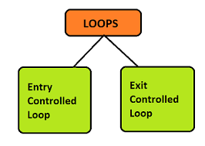
Loops

Slide 4
1. Entry controlled loop
In an entry-controlled loop, a condition is checked before executing the body of a loop.
It is also called as a pre-checking loop.
2. Exit controlled loop
In an exit-controlled loop a condition is checked after executing the body of a loop
It is also called as a post-checking loop.

Slide 5
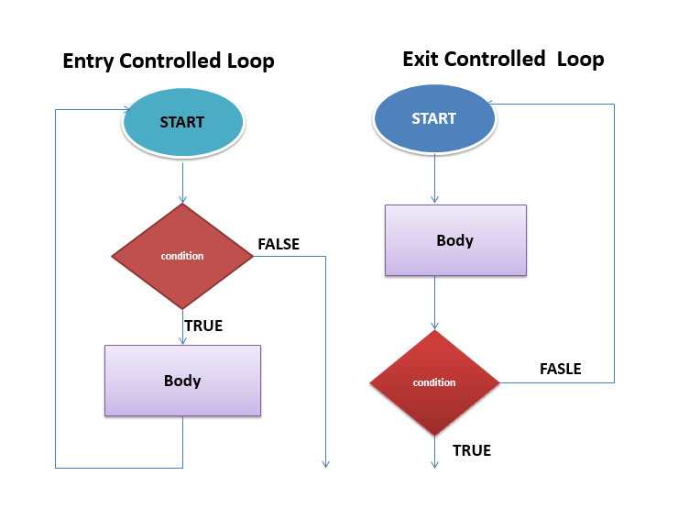

Slide 6
Loops

Slide 7
While Loop in C
The while loop evaluates the test expression inside the parenthesis ().
If the test expression is true, statements inside the body of while loop are executed.
The process goes on until the test expression is evaluated to false.
If the test expression is false, the loop terminates (ends).

Slide 8
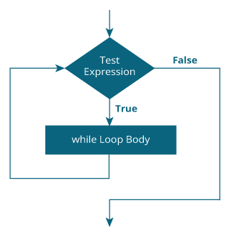
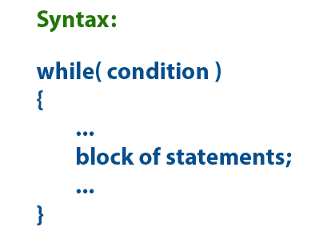
While Flow Chart
While Loop Syntax

Slide 9
While Loop Example 1
include <stdio.h>
int main()
{
int count=1;
while (count <= 4)
{
printf("%d ", count);
count++;
}
return 0;
}

Slide 10
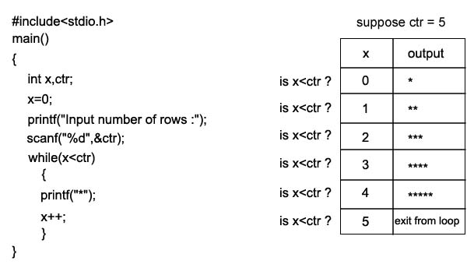
While loop Example- 2

Slide 11
Examples of infinite while loop Example 1:
#include <stdio.h>
int main()
{
int var = 6;
while (var >=5)
{
printf("%d", var);
var++;
}
return 0;
}
Infinite loop: var will always have value >=5 ,so the loop would never end.

Slide 12
Example 2
#include <stdio.h>
int main()
{
int var =5;
while (var <=10)
{
printf("%d", var);
var--;
}
return 0;
}
Infinite loop: var value will keep decreasing because of - - operator, hence it will always be <= 10.

Slide 13
Example of while loop using logical operator
include <stdio.h>
int main()
{
int i=1, j=1;
while (i <= 4 || j <= 3)
{
printf("%d %d\n",i, j);
i++;
j++;
}
return 0;
}
Output
1 1
2 2
3 3
4 4

Slide 14
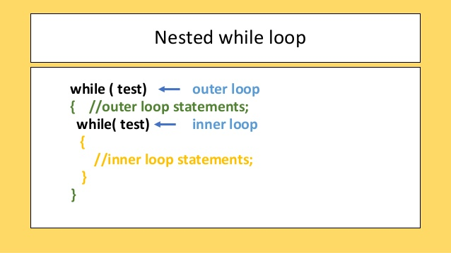

Slide 15
What are Nested Loops?
If a loop exists inside another loop, then it is a nested loop.
controls how many iterations the inner loop will undergo
OUTER LOOP
INNER LOOP
Executes multiple times
Statements;
Notes:
Latest Eid what does the doctor when a loop inside another job then we can call it as a nested loop so interested Lo we will have an outer loop which will be controlling how many iterations the inner loop will undergo the Inderlok will be placed Inside Out alone and the inner glow will also have certain execution which need to be done multiple Times and there will be statements within the inner loop which need to be executed the number of time the condition is specified inside the inner loop

Slide 16
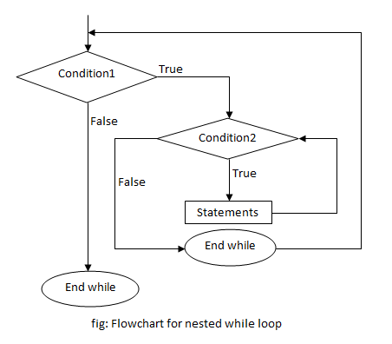
Nested While Loop

Slide 17
Nested While Loop- Example
#include<stdio.h>
int main()
{
int i = 0, j;
while(i <= 5)
{
printf("%d\t", i);
j = i + 1;
while(j <= 5)
{
printf("%d\t", j);
j = j + 1;
}
i = i + 1;
printf("\n");
}
return 0;
}
Output
0 1 2 3 4 5
1 2 3 4 5
3 4 5
4 5
5
5

Slide 18
For Loop
The for loop in C language is used to iterate the statements or a part of the program several times.
The syntax of the for loop is:
for (initializationStatement; testExpression; updateStatement)
{
// statements inside the body of loop
}

Slide 19
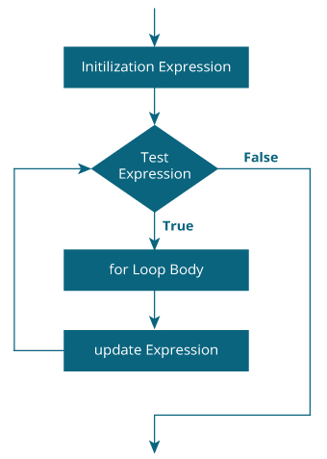
For Loop- Flow chart

Slide 20
How for loop works?
The initialization statement is executed only once.
Then, the test expression is evaluated. If the test expression is evaluated to false, the for loop is terminated.
However, if the test expression is evaluated to true, statements inside the body of for loop are executed, and the update expression is updated.
Again the test expression is evaluated.

Slide 21
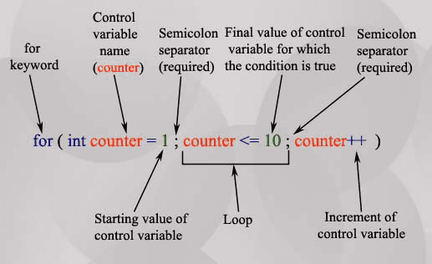
For loop syntax

Slide 22
Prints the numbers from 1 to 100 in increments of 1.
for ( int x = 1; x <= 100 ; x++ )
{
printf("%d\n",x);
}
Prints the numbers from 100 to 1 in increments of -1.
for(int x = 100 ; x >= 1; x--)
{
printf("%d\n",x);
}
The following code prints : 2, 7, 12, 17, 22, 27
for(int x = 2; x <= 30 ; x += 5)
{
printf("%d\n",x);
}

Slide 23
Example 1: for loop
/ Print numbers from 1 to 10
#include <stdio.h>
int main()
{
int i;
for (i = 1; i < 11; ++i)
{
printf("%d ", i);
}
return 0;
}
Output
1 2 3 4 5 6 7 8 9 10

Slide 24
Example 2: for loop
Program to calculate the sum of first n natural numbers
#include <stdio.h>
int main()
{
int num, count, sum = 0;
printf("Enter a positive integer: ");
scanf("%d", &num);
// for loop terminates when num is less than count
for(count = 1; count <= num; ++count)
{
sum += count;
}
printf("Sum = %d", sum);
return 0;
}
Output
Enter a positive integer: 10
Sum = 55

Slide 25
do-while loop
A do while loop is similar to while loop with one exception that it executes the statements inside the body of do-while before checking the condition.
In the while loop, first the condition is checked and then the statements in while
loop are executed.
If a condition is false at the first place then the do while would run once,
however the while loop would not run at all.

Slide 26
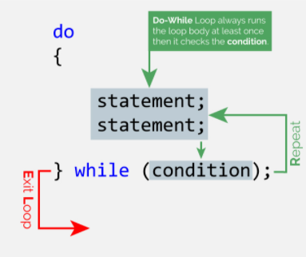
do - while loop – syntax.

Slide 27

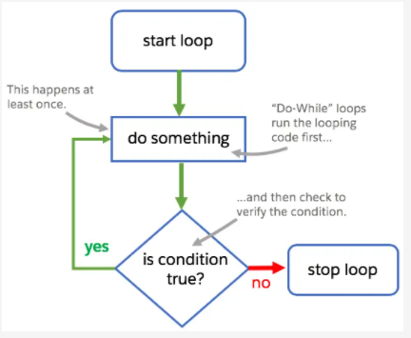

Slide 28
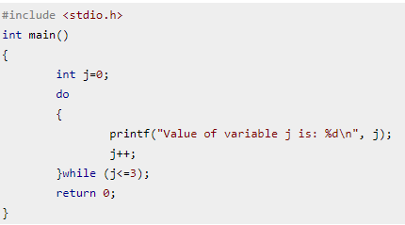


Example of do while loop

Slide 29


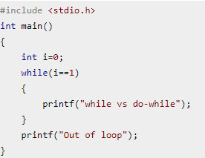


Slide 30
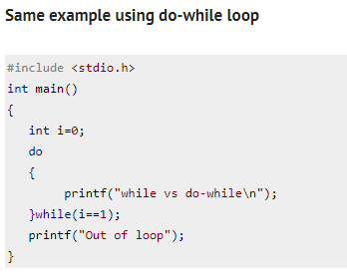
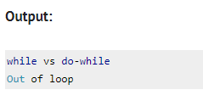

Slide 31


The continue statement is used inside loops.
When the continue statement is executed in the loop, the code inside the loop following the continue statement will be skipped and next iteration of the loop will begin.

Slide 32

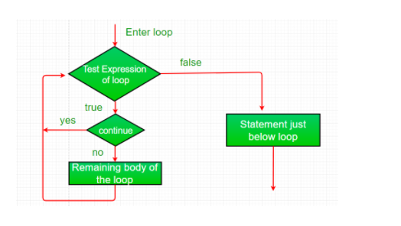

Slide 33
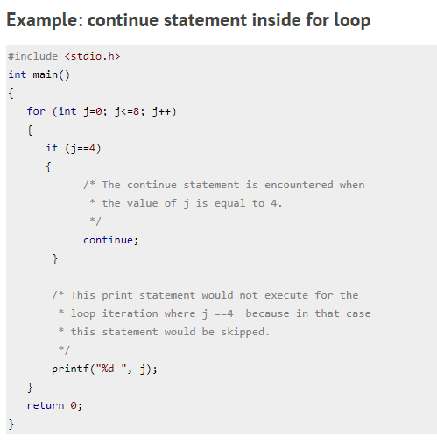



Slide 34

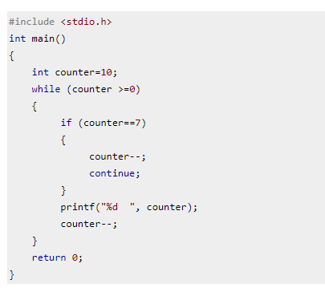


Slide 35

The break statement is used inside loops and switch case.
When a break statement is encountered inside a loop, the control directly comes out of loop and the loop gets terminated. It is used with if statement whenever used inside loop.
This can also be used in switch case control structure. Whenever it is encountered in switch-case block, the control comes out of the switch-case
Syntax:
break;

Slide 36
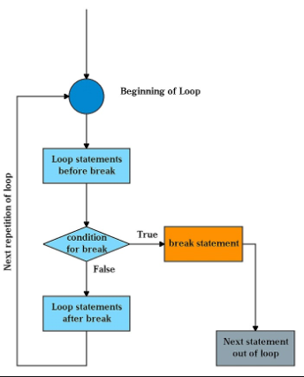
Flow chart for break statement

Slide 37
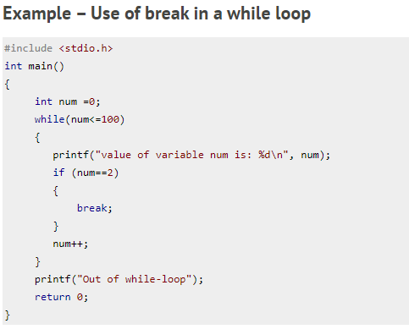
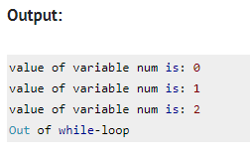

Slide 38
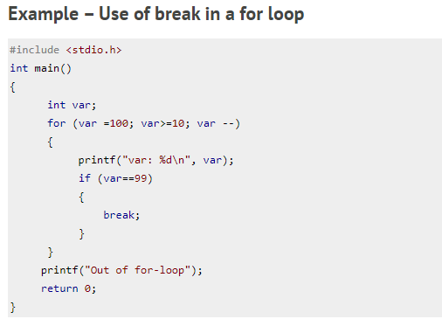
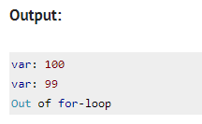

Slide 39
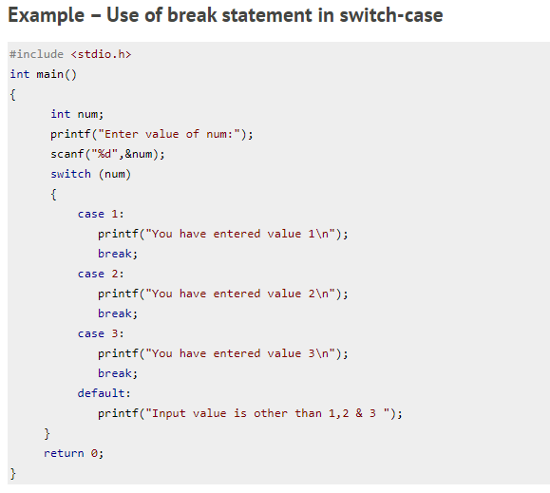
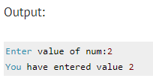
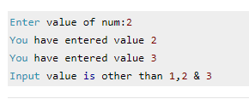
If we don’t use the break statement after every case block then the output of this program would be:

